Slide 1
London Analysis for Airbnb

Slide 2
Introduction
To find the best neighborhood for Airbnb in London, UK
Consider the following:
- Price per night
- Number of attractions

Slide 3


Data sources
Wikipedia: for London neighborhood information
Foursquare: for venue information of London
Insideairbnb.com: for detailed information about Airbnb listings in London

Slide 4
Methodology
Obtain the 33 neighborhood of London from Wikipedia, including name, longitude and latitude.
Use the longitude and latitude to get venue information within 500m of each neighborhood
Explore venue data and cluster neighborhood
Obtain detailed listing information of Airbnb in London, calculated the average price per bed per night for each neighborhood
Merged the above data to get a consolidated dataset.
Sorted the neighborhood by average price and number of venues.

Slide 5
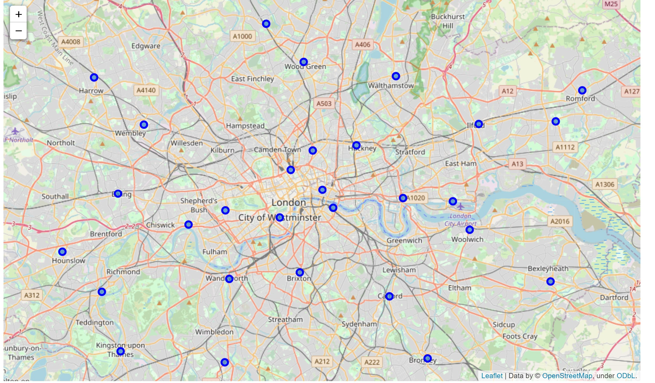
Map of london

Slide 6
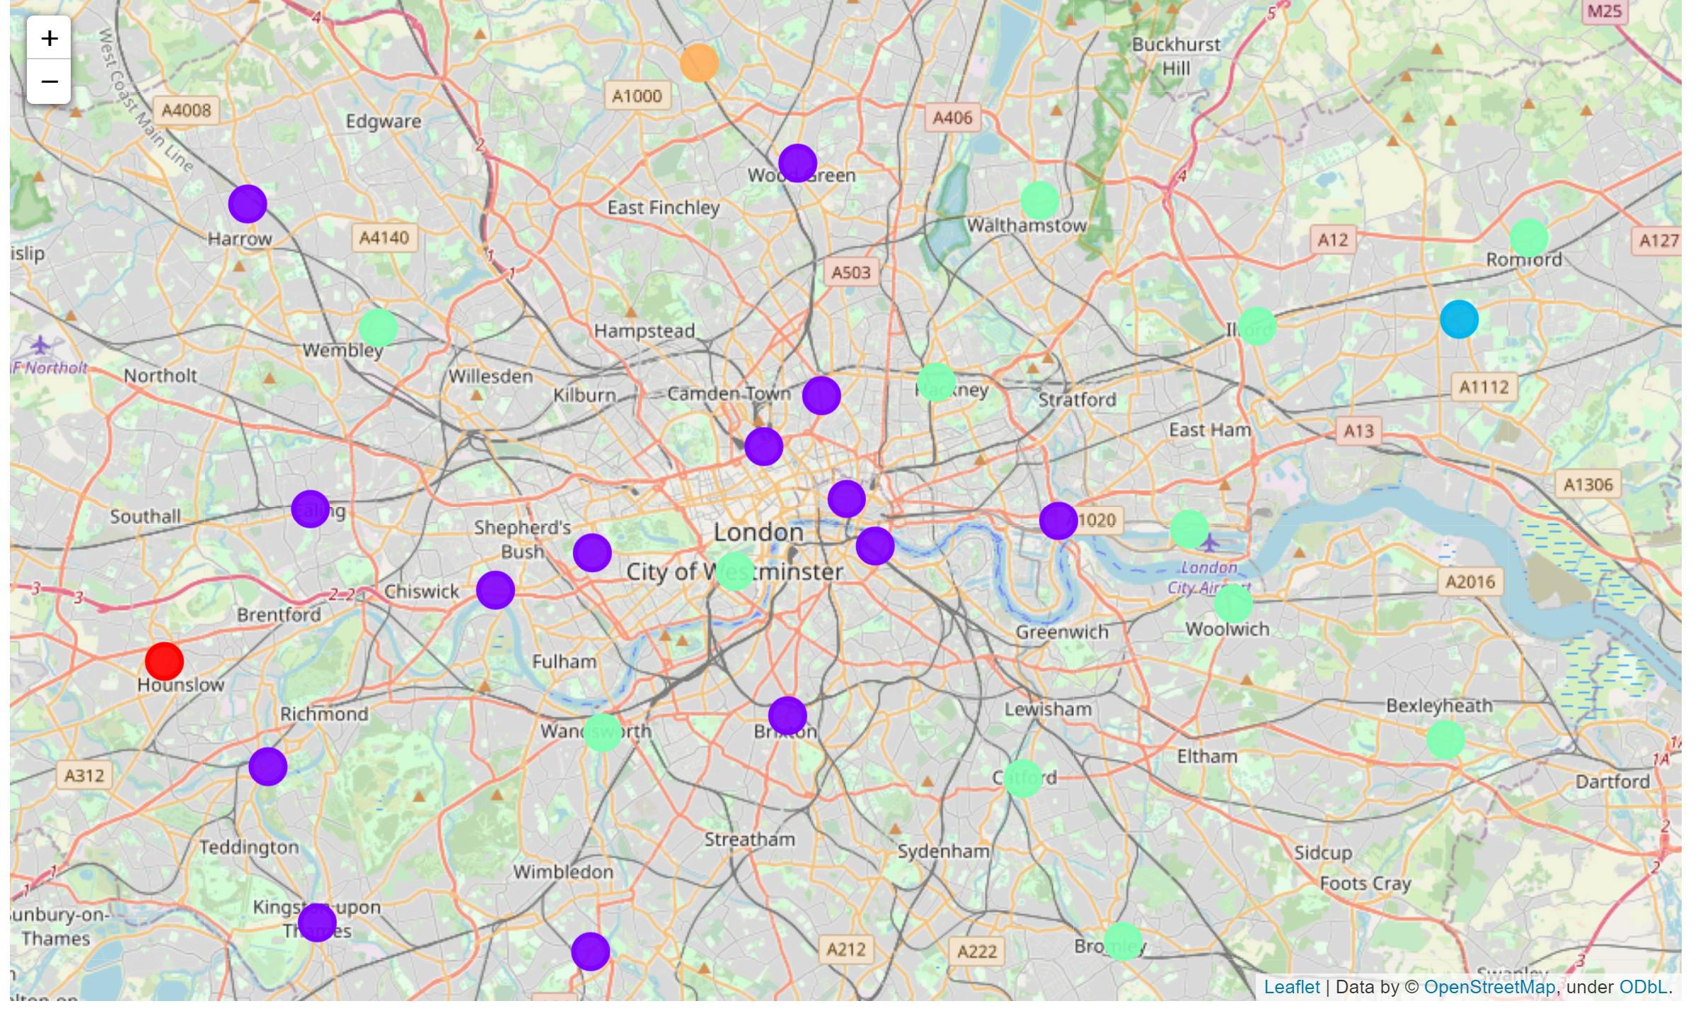
Clustered map of London ( 5 clusters with kmeans)

Slide 7
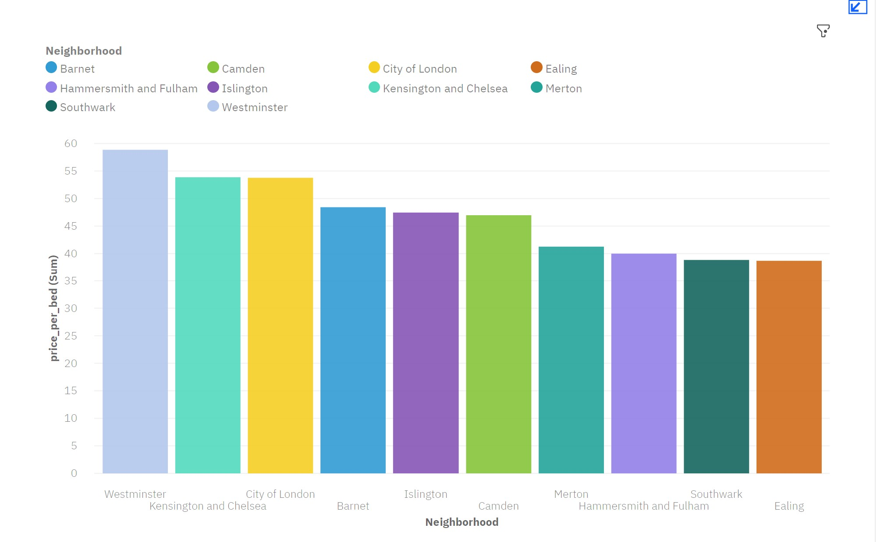
Top ten neighborhood in price per bed

Slide 8
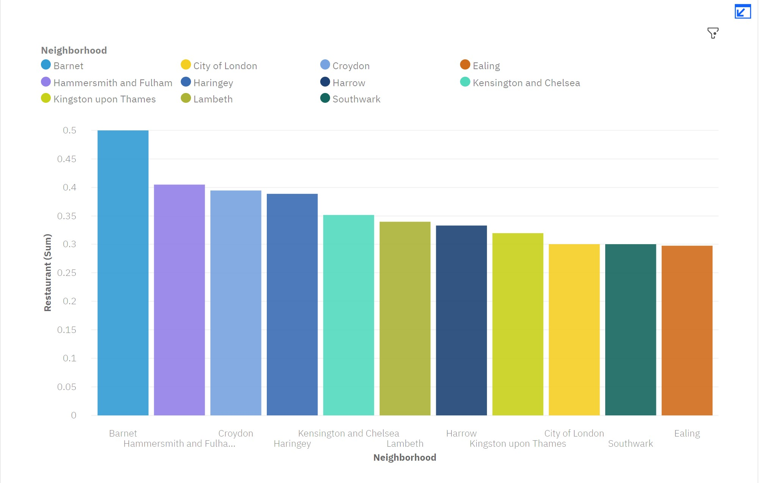
Top ten neighborhood in average number of restaurant

Slide 9
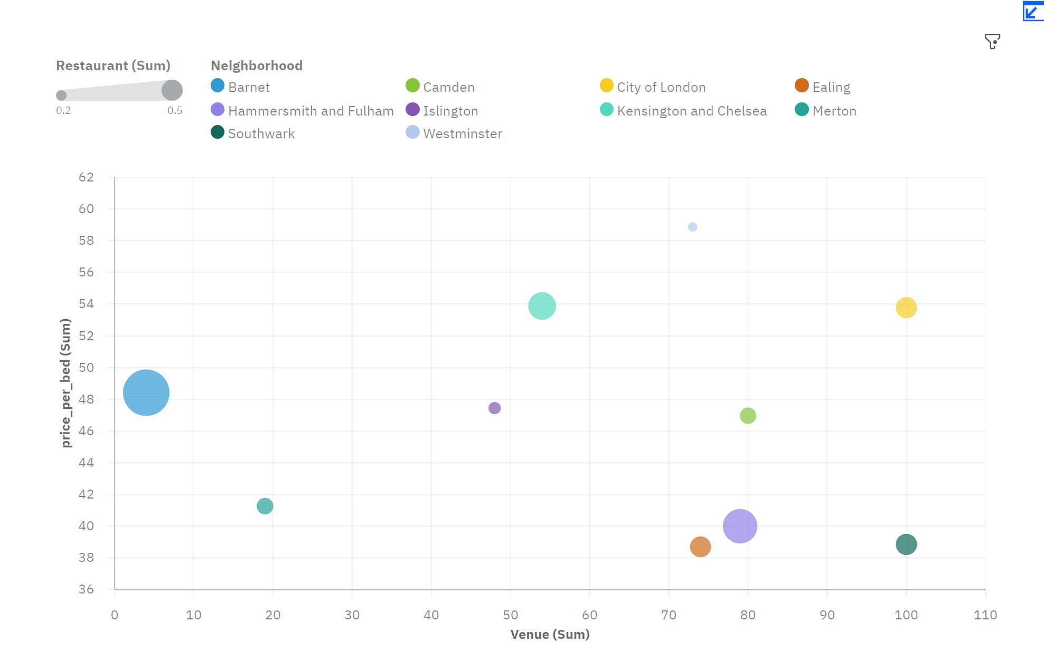
Combined data map including restaurant, price per bed and number of venue (top ten)

Slide 10

Conclusion
Three best neighborhood to consider
- Kensington and Chelsea
- City of London
- Barnet

